Slide 1
Z - Test
Z test is a statistical test that is conducted on data that approximately follows a normal distribution.
The z test can be performed on one sample, two samples, or on proportions for hypothesis testing.
It checks if the means of two large samples are different or not when the population variance is known.

Slide 2
Z Test Definition
A z test is conducted on a population that follows a normal distribution with independent data points and has a sample size that is greater than or equal to 30.
It is used to check whether the means of two populations are equal to each other when the population variance is known.
The null hypothesis of a z test can be rejected if the z test statistic is statistically significant when compared with the critical value

Slide 3
Z – Test Formula
One-Sample Z Test
A one-sample z test is used to check if there is a difference between the sample mean and the population mean when the population standard deviation is known.
$\overline{x}$ is the sample mean, μ is the population mean, σ is the population standard deviation and n is the sample size.

Slide 4
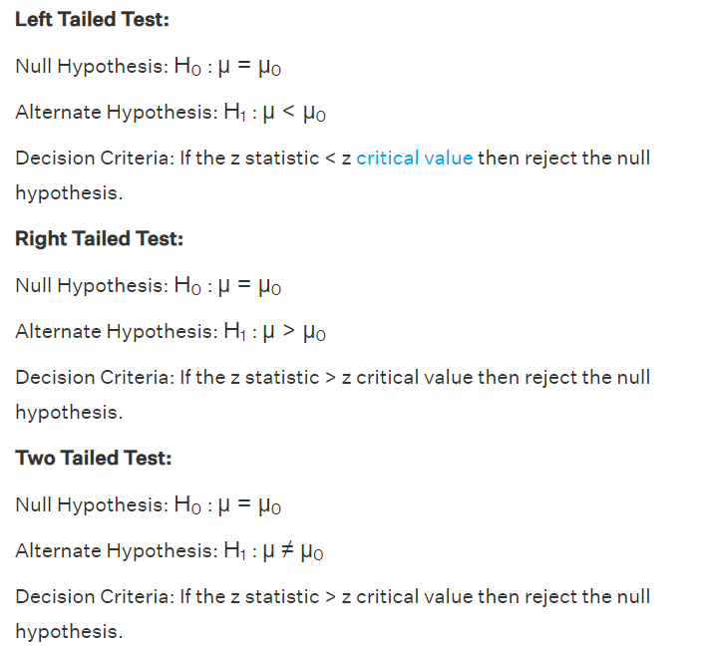
Z-Test Formula
The algorithm to set a one sample z test based on the z test statistic is given as follows:

Slide 5
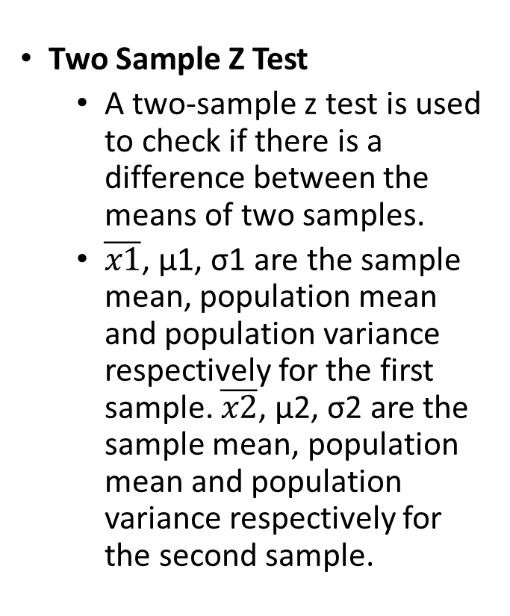
Z- Test Formula
Two Sample Z Test
A two-sample z test is used to check if there is a difference between the means of two samples.
$\overline{x1}$, μ1, σ1 are the sample mean, population mean and population variance respectively for the first sample. $\overline{x2}$, μ2, σ2 are the sample mean, population mean and population variance respectively for the second sample.

